Slide 1
Classification: Probabilistic Generative Model

Slide 2
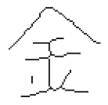

Classification
Function
$$x$$
Class n
Credit Scoring
Input: income, savings, profession, age, past financial history ……
Output: accept or refuse
Medical Diagnosis
Input: current symptoms, age, gender, past medical history ……
Output: which kind of diseases
Handwritten character recognition
Face recognition
Input: image of a face, output: person
output:
Input:
金

Slide 3
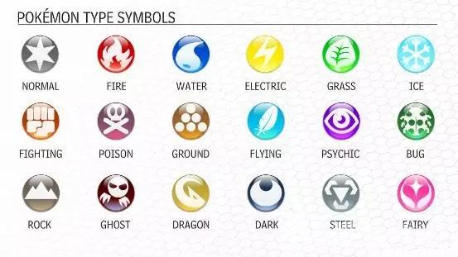









Example Application
$$f\left( \right)=$$
$$f\left( \right)=$$
$$f\left( \right)=$$

Slide 4
Example Application
pokemon games (NOT pokemon cards or Pokemon Go)
Total: sum of all stats that come after this, a general guide to how strong a pokemon is
HP: hit points, or health, defines how much damage a pokemon can withstand before fainting
Attack: the base modifier for normal attacks (eg. Scratch, Punch)
Defense: the base damage resistance against normal attacks
SP Atk: special attack, the base modifier for special attacks (e.g. fire blast, bubble beam)
SP Def: the base damage resistance against special attacks
Speed: determines which pokemon attacks first each round
320
35
55
40
50
50
90
Can we predict the “type” of pokemon based on the information?
Notes:
Total 7 features
320,35,55,40,50,50,90

Slide 5
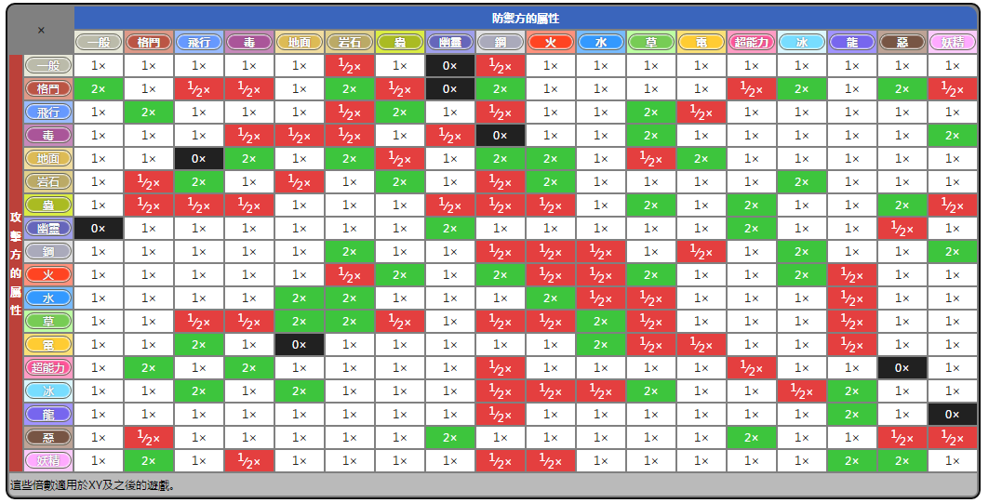
Example Application
Notes:
Predict the type that you have never seen before

Slide 6




How to do Classification
Training data for Classification
$$\left(x^{1},{\hat{y}}^{1}\right)$$
$$\left(x^{2},{\hat{y}}^{2}\right)$$
$$……$$
$$\left(x^{N},{\hat{y}}^{N}\right)$$
Classification as Regression?
Binary classification as example
Training: Class 1 means the target is 1; Class 2 means the target is -1
Testing: closer to 1 $→$ class 1; closer to -1 $→$ class 2

Slide 7
b + w₁x₁ + w₁x₁ = 0
to decrease error
Class 2
Class 2
-1
-1
Multiple class: Class 1 means the target is 1; Class 2 means the target is 2; Class 3 means the target is 3 …… problematic
1
1
x₂
x₂
Class 1
Class 1
>>1
y = b + w₁x₁ + w₂x₂
error
x₁
x₁
Penalize to the examples that are “too correct” …
(Bishop, P186)
Notes:
-0.142857142857 0.285714285714

Slide 8


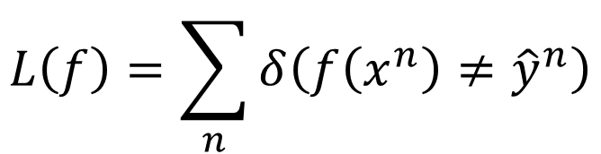


Ideal Alternatives
$$f\left(x\right)$$
Function (Model):
Loss function:
Find the best function:
Example: Perceptron, SVM
$$g\left(x\right)>0$$
Output = class 1
$$x$$
$$else$$
Output = class 2
$$L\left(f\right)=\sum_{n}{δ\left(f\left(x^{n}\right)≠{\hat{y}}^{n}\right)}$$
The number of times f get incorrect results on training data.
Not Today

Slide 9
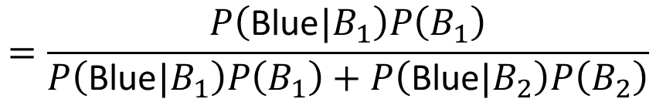
Two Boxes
Box 1
Box 2
P(B₁) = 2/3
P(B₂) = 1/3
P(Blue|B₁) = 4/5
P(Blue|B₁) = 2/5
P(Green|B₁) = 1/5
P(Green|B₁) = 3/5
from one of the boxes
Where does it come from?
$$=\frac{P\left(\text{Blue}|B_{1}\right)P\left(B_{1}\right)}{P\left(\text{Blue}|B_{1}\right)P\left(B_{1}\right)+P\left(\text{Blue}|B_{2}\right)P\left(B_{2}\right)}$$
P(B₁ | Blue)

Slide 10
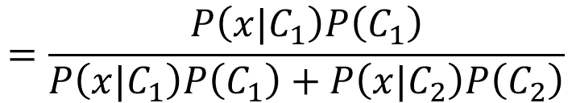



Two Classes
Estimating the Probabilities
From training data
Class 1
Class 2
P(C₁)
P(C₂)
P(x|C₁)
P(x|C₂)
Given an x, which class does it belong to
$$=\frac{P\left(x|C_{1}\right)P\left(C_{1}\right)}{P\left(x|C_{1}\right)P\left(C_{1}\right)+P\left(x|C_{2}\right)P\left(C_{2}\right)}$$
$$P\left(C_{1}|x\right)$$
Generative Model
$$P\left(x\right)$$
$$=P\left(x|C_{1}\right)P\left(C_{1}\right)+P\left(x|C_{2}\right)P\left(C_{2}\right)$$
Notes:
Outlier detection

Slide 11
Prior
Class 1
Class 2
P(C₁)
P(C₂)
Water
Normal
Water and Normal type with ID < 400 for training, rest for testing
Training: 79 Water, 61 Normal
P(C₁) = 79 / (79 + 61) =0.56
P(C₂) = 61 / (79 + 61) =0.44

Slide 12



Probability from Class
P(x|C₁) = ?
P( |Water)
= ?
Each Pokémon is represented as a vector by its attribute.
feature
79 in total
Water
Type
Notes:
Tirtouga

Slide 13
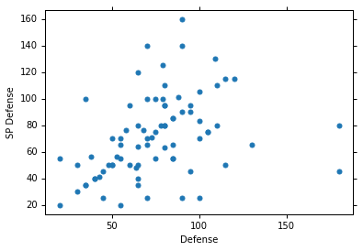



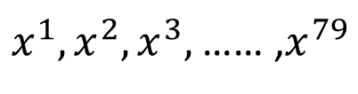
Probability from Class - Feature
Considering Defense and SP Defense
$$\left[\begin{aligned}48 \\ 50\end{aligned}\right]$$
$x^{1},x^{2},x^{3},$ …… ,$x^{79}$
$$\left[\begin{aligned}65 \\ 64\end{aligned}\right]$$
P(x|Water)=?
0?
Assume the points are sampled from a Gaussian distribution.
$$\left[\begin{aligned}103 \\ 45\end{aligned}\right]$$
Water
Type

Slide 14
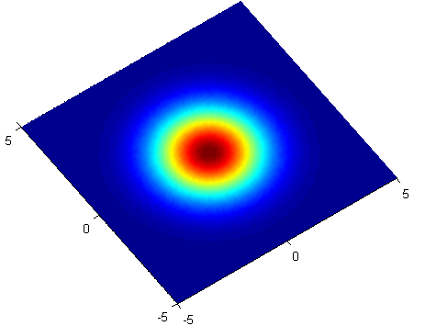
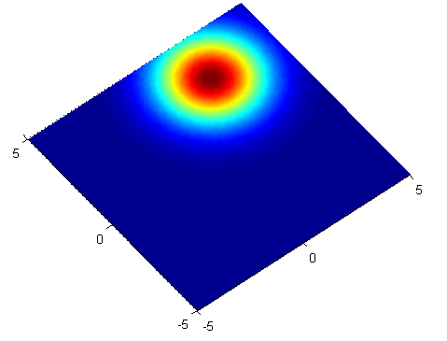





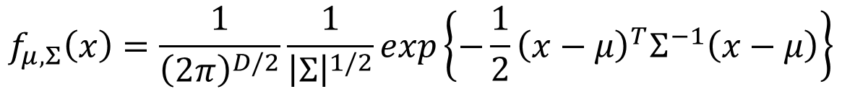

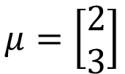
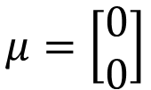

Gaussian Distribution
https://blog.slinuxer.com/tag/pca
$$f_{μ,Σ}\left(x\right)=\frac{1}{{\left(2π\right)}^{D/2}}\frac{1}{{\left|Σ\right|}^{1/2}}exp\left\{−\frac{1}{2}{\left(x−μ\right)}^{T}Σ^{−1}\left(x−μ\right)\right\}$$
Input: vector x, output: probability of sampling x
The shape of the function determines by mean $μ$ and covariance matrix $Σ$
$$μ=\left[\begin{aligned}0 \\ 0\end{aligned}\right]$$
$$\sum{=}\left[\begin{matrix}2 & 0 \\ 0 & 2\end{matrix}\right]$$
$$μ=\left[\begin{aligned}2 \\ 3\end{aligned}\right]$$
$$\sum{=}\left[\begin{matrix}2 & 0 \\ 0 & 2\end{matrix}\right]$$
$$x_{2}$$
$$x_{2}$$
$$x_{1}$$
$$x_{1}$$

Slide 15
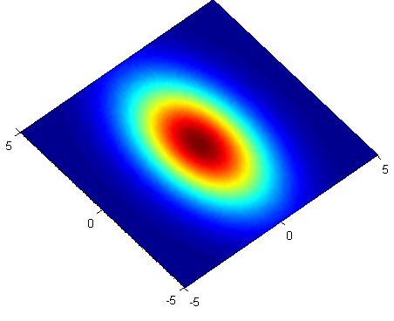
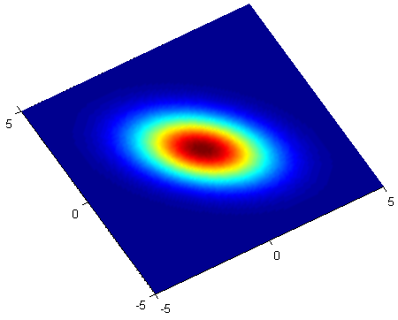


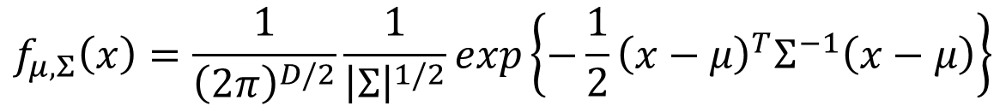

Gaussian Distribution
https://blog.slinuxer.com/tag/pca
$$f_{μ,Σ}\left(x\right)=\frac{1}{{\left(2π\right)}^{D/2}}\frac{1}{{\left|Σ\right|}^{1/2}}exp\left\{−\frac{1}{2}{\left(x−μ\right)}^{T}Σ^{−1}\left(x−μ\right)\right\}$$
Input: vector x, output: probability of sampling x
The shape of the function determines by mean $μ$ and covariance matrix $Σ$
$$μ=\left[\begin{aligned}0 \\ 0\end{aligned}\right]$$
$$\sum{=}\left[\begin{matrix}2 & 0 \\ 0 & 6\end{matrix}\right]$$
$$μ=\left[\begin{aligned}0 \\ 0\end{aligned}\right]$$
$$\sum{=}\left[\begin{matrix}2 & −1 \\ −1 & 2\end{matrix}\right]$$
$$x_{2}$$
$$x_{2}$$
$$x_{1}$$
$$x_{1}$$
Notes:
Ref: https://www.cs.cmu.edu/~epxing/Class/10701-08s/recitation/gaussian.pdf

Slide 16

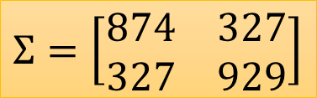

Probability from Class
Assume the points are sampled from a Gaussian distribution
Find the Gaussian distribution behind them
Probability for new points
$x^{1},x^{2},x^{3},$ …… ,$x^{79}$
New x
$$μ=\left[\begin{aligned}75.0 \\ 71.3\end{aligned}\right]$$
$$Σ=\left[\begin{matrix}874 & 327 \\ 327 & 929\end{matrix}\right]$$
How to find them?
Water
Type
$$f_{μ,Σ}\left(x\right)=\frac{1}{{\left(2π\right)}^{D/2}}\frac{1}{{\left|Σ\right|}^{1/2}}exp\left\{−\frac{1}{2}{\left(x−μ\right)}^{T}Σ^{−1}\left(x−μ\right)\right\}$$

Slide 17
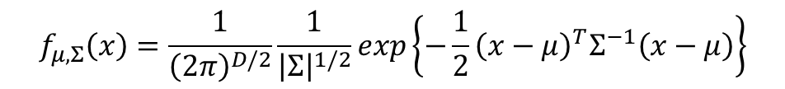
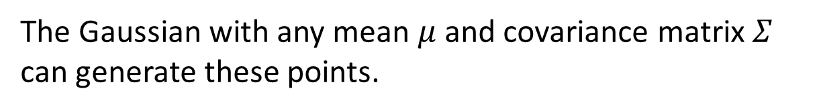
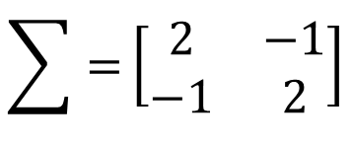
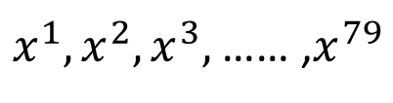
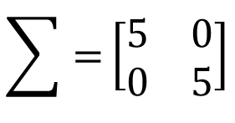
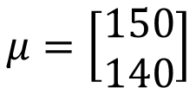
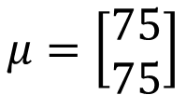

Maximum Likelihood
$$f_{μ,Σ}\left(x\right)=\frac{1}{{\left(2π\right)}^{D/2}}\frac{1}{{\left|Σ\right|}^{1/2}}exp\left\{−\frac{1}{2}{\left(x−μ\right)}^{T}Σ^{−1}\left(x−μ\right)\right\}$$
$$\sum{=}\left[\begin{matrix}5 & 0 \\ 0 & 5\end{matrix}\right]$$
$x^{1},x^{2},x^{3},$ …… ,$x^{79}$
$$μ=\left[\begin{aligned}150 \\ 140\end{aligned}\right]$$
$$\sum{=}\left[\begin{matrix}2 & −1 \\ −1 & 2\end{matrix}\right]$$
$$μ=\left[\begin{aligned}75 \\ 75\end{aligned}\right]$$
The Gaussian with any mean $μ$ and covariance matrix $Σ$ can generate these points.
Different Likelihood
Likelihood of a Gaussian with mean $μ$ and covariance matrix $Σ$
= the probability of the Gaussian samples $x^{1},x^{2},x^{3},$ …… ,$x^{79}$
$$L\left(μ,Σ\right)$$
$$=f_{μ,Σ}\left(x^{1}\right)f_{μ,Σ}\left(x^{2}\right)f_{μ,Σ}\left(x^{3}\right)……f_{μ,Σ}\left(x^{79}\right)$$

Slide 18
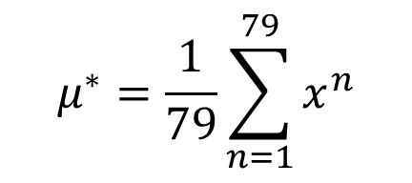
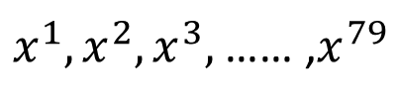
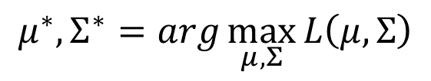




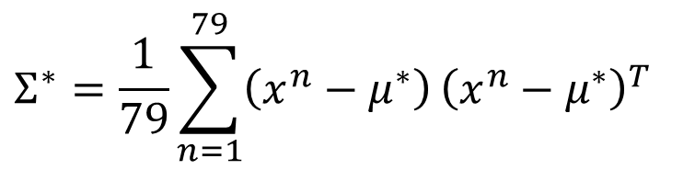
Maximum Likelihood
We have the “Water” type Pokémons:
$x^{1},x^{2},x^{3},$ …… ,$x^{79}$
We assume $x^{1},x^{2},x^{3},$ …… ,$x^{79}$ generate from the Gaussian ($μ^{∗},Σ^{∗}$) with the maximum likelihood
$$L\left(μ,Σ\right)$$
$$=f_{μ,Σ}\left(x^{1}\right)f_{μ,Σ}\left(x^{2}\right)f_{μ,Σ}\left(x^{3}\right)……f_{μ,Σ}\left(x^{79}\right)$$
$$f_{μ,Σ}\left(x\right)=\frac{1}{{\left(2π\right)}^{D/2}}\frac{1}{{\left|Σ\right|}^{1/2}}exp\left\{−\frac{1}{2}{\left(x−μ\right)}^{T}Σ^{−1}\left(x−μ\right)\right\}$$
$$μ^{∗},Σ^{∗}=arg\max_{μ,Σ}{L\left(μ,Σ\right)}$$
$$μ^{∗}=\frac{1}{79}\sum_{n=1}^{79}{x^{n}}$$
$$Σ^{∗}=\frac{1}{79}\sum_{n=1}^{79}{\left(x^{n}−μ^{∗}\right)}{\left(x^{n}−μ^{∗}\right)}^{T}$$
average

Slide 19
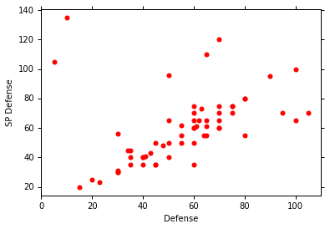
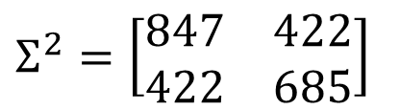
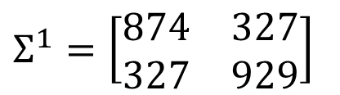
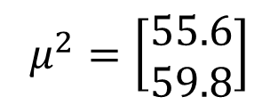
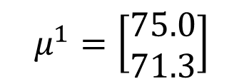
Maximum Likelihood
Class 1: Water
Class 2: Normal
$$μ^{1}=\left[\begin{aligned}75.0 \\ 71.3\end{aligned}\right]$$
$$Σ^{1}=\left[\begin{matrix}874 & 327 \\ 327 & 929\end{matrix}\right]$$
$$μ^{2}=\left[\begin{aligned}55.6 \\ 59.8\end{aligned}\right]$$
$$Σ^{2}=\left[\begin{matrix}847 & 422 \\ 422 & 685\end{matrix}\right]$$
Notes:
[[ 873.85931742 327.20269188] [ 327.20269188 928.67649415]]
[[ 847.77317895 421.65495494] [ 421.65495494 684.78459736]]

Slide 20

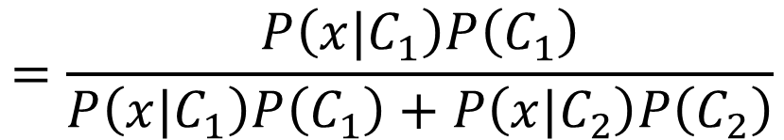

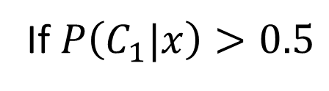



Now we can do classification ☺
$$f_{μ^{1},Σ^{1}}\left(x\right)=\frac{1}{{\left(2π\right)}^{D/2}}\frac{1}{{\left|Σ^{1}\right|}^{1/2}}exp\left\{−\frac{1}{2}{\left(x−μ^{1}\right)}^{T}{\left(Σ^{1}\right)}^{−1}\left(x−μ^{1}\right)\right\}$$
P(C1)
= 79 / (79 + 61) =0.56
$$μ^{1}=\left[\begin{aligned}75.0 \\ 71.3\end{aligned}\right]$$
$$Σ^{1}=\left[\begin{matrix}874 & 327 \\ 327 & 929\end{matrix}\right]$$
$$=\frac{P\left(x|C_{1}\right)P\left(C_{1}\right)}{P\left(x|C_{1}\right)P\left(C_{1}\right)+P\left(x|C_{2}\right)P\left(C_{2}\right)}$$
$$P\left(C_{1}|x\right)$$
$$f_{μ^{2},Σ^{2}}\left(x\right)=\frac{1}{{\left(2π\right)}^{D/2}}\frac{1}{{\left|Σ^{2}\right|}^{1/2}}exp\left\{−\frac{1}{2}{\left(x−μ^{2}\right)}^{T}{\left(Σ^{2}\right)}^{−1}\left(x−μ^{2}\right)\right\}$$
P(C2)
= 61 / (79 + 61)
=0.44
$$μ^{2}=\left[\begin{aligned}55.6 \\ 59.8\end{aligned}\right]$$
$$Σ^{2}=\left[\begin{matrix}847 & 422 \\ 422 & 685\end{matrix}\right]$$
If $P\left(C_{1}|x\right)>0.5$
x belongs to class 1 (Water)

Slide 21
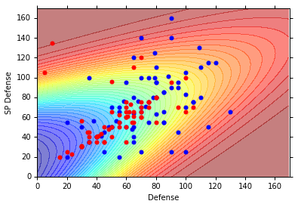
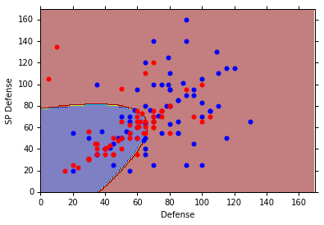
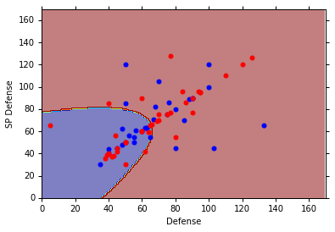







$$P\left(C_{1}|x\right)$$
$$>0.5$$
$$P\left(C_{1}|x\right)$$
$$P\left(C_{1}|x\right)<0.5$$
Blue points: C₁ (Water), Red points: C₂ (Normal)
How’s the results?
$$P\left(C_{1}|x\right)$$
$$>0.5$$
Testing data: 47% accuracy
All: total, hp, att, sp att,
de, sp de, speed (7 features)
$μ^{1},μ^{2}:$ 7-dim vector
$Σ^{1},Σ^{2}:$ 7 x 7 matrices
$$P\left(C_{1}|x\right)<0.5$$
54% accuracy … ☹

Slide 22
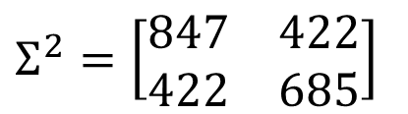
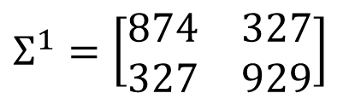
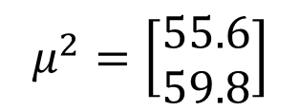
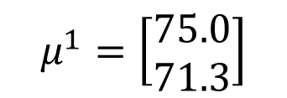

Modifying Model
Class 1: Water
Class 2: Normal
$$μ^{1}=\left[\begin{aligned}75.0 \\ 71.3\end{aligned}\right]$$
$$Σ^{1}=\left[\begin{matrix}874 & 327 \\ 327 & 929\end{matrix}\right]$$
$$μ^{2}=\left[\begin{aligned}55.6 \\ 59.8\end{aligned}\right]$$
$$Σ^{2}=\left[\begin{matrix}847 & 422 \\ 422 & 685\end{matrix}\right]$$
The same $Σ$
Less parameters
Notes:
Do I realy overfit the data

Slide 23








Modifying Model
Ref: Bishop, chapter 4.2.2
Maximum likelihood
“Water” type Pokémons:
“Normal” type Pokémons:
$x^{1},x^{2},x^{3},$ …… ,$x^{79}$
$x^{80},x^{81},x^{82},$ …… ,$x^{140}$
$$μ^{1}$$
$Σ$
$$μ^{2}$$
Find $μ^{1}$, $μ^{2}$, $Σ$ maximizing the likelihood $L\left(μ^{1}\text{,}μ^{2}\text{,}Σ\right)$
$$L\left(μ^{1}\text{,}μ^{2}\text{,}Σ\right)=f_{μ^{1},Σ}\left(x^{1}\right)f_{μ^{1},Σ}\left(x^{2}\right)⋯f_{μ^{1},Σ}\left(x^{79}\right)$$
$$×f_{μ^{2},Σ}\left(x^{80}\right)f_{μ^{2},Σ}\left(x^{81}\right)⋯f_{μ^{2},Σ}\left(x^{140}\right)$$
$μ^{1}$ and $μ^{2}$ is the same
$Σ=\frac{79}{140}Σ^{1}+\frac{61}{140}Σ^{2}$

Slide 24

Modifying Model
The boundary is linear
The same covariance matrix
All: total, hp, att, sp att, de, sp de, speed
54% accuracy
73% accuracy
Notes:
Indenty: 50% accuracy
Share diagonal
: 56%
Indenty: 54%
Not Shared diagonal

Slide 25




Three Steps
Function Set (Model):
Goodness of a function:
The mean $μ$ and covariance $Σ$ that maximizing the likelihood (the probability of generating data)
Find the best function: easy
$$P\left(C_{1}|x\right)=\frac{P\left(x|C_{1}\right)P\left(C_{1}\right)}{P\left(x|C_{1}\right)P\left(C_{1}\right)+P\left(x|C_{2}\right)P\left(C_{2}\right)}$$
$$x$$
If $P\left(C_{1}|x\right)>0.5$, output: class 1
Otherwise, output: class 2

Slide 26





Probability Distribution
You can always use the distribution you like ☺
$$P\left(x|C_{1}\right)$$
$$=P\left(x_{1}|C_{1}\right)$$
$$P\left(x_{2}|C_{1}\right)$$
……
$$P\left(x_{k}|C_{1}\right)$$
……
$$\left[\begin{aligned}x_{1} \\ x_{2} \\ ⋮ \\ x_{k} \\ ⋮ \\ x_{K}\end{aligned}\right]$$
1-D Gaussian
For binary features, you may assume they are from Bernoulli distributions.
If you assume all the dimensions are independent, then you are using Naive Bayes Classifier.

Slide 27






Posterior Probability
$$P\left(C_{1}|x\right)=\frac{P\left(x|C_{1}\right)P\left(C_{1}\right)}{P\left(x|C_{1}\right)P\left(C_{1}\right)+P\left(x|C_{2}\right)P\left(C_{2}\right)}$$
$$=\frac{1}{1+\frac{P\left(x|C_{2}\right)P\left(C_{2}\right)}{P\left(x|C_{1}\right)P\left(C_{1}\right)}}$$
$$=\frac{1}{1+exp\left(−z\right)}$$
$$=σ\left(z\right)$$
Sigmoid function
$$z=ln\frac{P\left(x|C_{1}\right)P\left(C_{1}\right)}{P\left(x|C_{2}\right)P\left(C_{2}\right)}$$

Slide 28
Warning of Math

Slide 29






Posterior Probability
$$z=ln\frac{P\left(x|C_{1}\right)P\left(C_{1}\right)}{P\left(x|C_{2}\right)P\left(C_{2}\right)}$$
$$P\left(C_{1}|x\right)$$
$$=σ\left(z\right)$$
sigmoid
$$\frac{\frac{N_{1}}{N_{1}+N_{2}}}{\frac{N_{2}}{N_{1}+N_{2}}}$$
$$z=ln\frac{P\left(x|C_{1}\right)}{P\left(x|C_{2}\right)}+ln\frac{P\left(C_{1}\right)}{P\left(C_{2}\right)}$$
$$=\frac{N_{1}}{N_{2}}$$
$$P\left(x|C_{1}\right)=\frac{1}{{\left(2π\right)}^{D/2}}\frac{1}{{\left|Σ^{1}\right|}^{1/2}}exp\left\{−\frac{1}{2}{\left(x−μ^{1}\right)}^{T}{\left(Σ^{1}\right)}^{−1}\left(x−μ^{1}\right)\right\}$$
$$P\left(x|C_{2}\right)=\frac{1}{{\left(2π\right)}^{D/2}}\frac{1}{{\left|Σ^{2}\right|}^{1/2}}exp\left\{−\frac{1}{2}{\left(x−μ^{2}\right)}^{T}{\left(Σ^{2}\right)}^{−1}\left(x−μ^{2}\right)\right\}$$

Slide 30




$$z=ln\frac{P\left(x|C_{1}\right)}{P\left(x|C_{2}\right)}+ln\frac{P\left(C_{1}\right)}{P\left(C_{2}\right)}$$
$$=\frac{N_{1}}{N_{2}}$$
$$P\left(x|C_{1}\right)=\frac{1}{{\left(2π\right)}^{D/2}}\frac{1}{{\left|Σ^{1}\right|}^{1/2}}exp\left\{−\frac{1}{2}{\left(x−μ^{1}\right)}^{T}{\left(Σ^{1}\right)}^{−1}\left(x−μ^{1}\right)\right\}$$
$$P\left(x|C_{2}\right)=\frac{1}{{\left(2π\right)}^{D/2}}\frac{1}{{\left|Σ^{2}\right|}^{1/2}}exp\left\{−\frac{1}{2}{\left(x−μ^{2}\right)}^{T}{\left(Σ^{2}\right)}^{−1}\left(x−μ^{2}\right)\right\}$$
$$ln\frac{\frac{1}{{\left(2π\right)}^{D/2}}\frac{1}{{\left|Σ^{1}\right|}^{1/2}}exp\left\{−\frac{1}{2}{\left(x−μ^{1}\right)}^{T}{\left(Σ^{1}\right)}^{−1}\left(x−μ^{1}\right)\right\}}{\frac{1}{{\left(2π\right)}^{D/2}}\frac{1}{{\left|Σ^{2}\right|}^{1/2}}exp\left\{−\frac{1}{2}{\left(x−μ^{2}\right)}^{T}{\left(Σ^{2}\right)}^{−1}\left(x−μ^{2}\right)\right\}}$$
$$=ln\frac{{\left|Σ^{2}\right|}^{1/2}}{{\left|Σ^{1}\right|}^{1/2}}exp\left\{−\frac{1}{2}\left[{\left(x−μ^{1}\right)}^{T}{\left(Σ^{1}\right)}^{−1}\left(x−μ^{1}\right)−{\left(x−μ^{2}\right)}^{T}{\left(Σ^{2}\right)}^{−1}\left(x−μ^{2}\right)\right]\right\}$$
$$=ln\frac{{\left|Σ^{2}\right|}^{1/2}}{{\left|Σ^{1}\right|}^{1/2}}−\frac{1}{2}\left[{\left(x−μ^{1}\right)}^{T}{\left(Σ^{1}\right)}^{−1}\left(x−μ^{1}\right)−{\left(x−μ^{2}\right)}^{T}{\left(Σ^{2}\right)}^{−1}\left(x−μ^{2}\right)\right]$$

Slide 31






$$z=ln\frac{P\left(x|C_{1}\right)}{P\left(x|C_{2}\right)}+ln\frac{P\left(C_{1}\right)}{P\left(C_{2}\right)}$$
$$=\frac{N_{1}}{N_{2}}$$
$$=ln\frac{{\left|Σ^{2}\right|}^{1/2}}{{\left|Σ^{1}\right|}^{1/2}}−\frac{1}{2}\left[{\left(x−μ^{1}\right)}^{T}{\left(Σ^{1}\right)}^{−1}\left(x−μ^{1}\right)−{\left(x−μ^{2}\right)}^{T}{\left(Σ^{2}\right)}^{−1}\left(x−μ^{2}\right)\right]$$
$${\left(x−μ^{1}\right)}^{T}{\left(Σ^{1}\right)}^{−1}\left(x−μ^{1}\right)$$
$=x^{T}{\left(Σ^{1}\right)}^{−1}x−x^{T}{\left(Σ^{1}\right)}^{−1}μ^{1}−{\left(μ^{1}\right)}^{T}{\left(Σ^{1}\right)}^{−1}x$ $+{\left(μ^{1}\right)}^{T}{\left(Σ^{1}\right)}^{−1}μ^{1}$
$$=x^{T}{\left(Σ^{1}\right)}^{−1}x−2{\left(μ^{1}\right)}^{T}{\left(Σ^{1}\right)}^{−1}x+{\left(μ^{1}\right)}^{T}{\left(Σ^{1}\right)}^{−1}μ^{1}$$
$${\left(x−μ^{2}\right)}^{T}{\left(Σ^{2}\right)}^{−1}\left(x−μ^{2}\right)$$
$$=x^{T}{\left(Σ^{2}\right)}^{−1}x−2{\left(μ^{2}\right)}^{T}{\left(Σ^{2}\right)}^{−1}x+{\left(μ^{2}\right)}^{T}{\left(Σ^{2}\right)}^{−1}μ^{2}$$
$$z=ln\frac{{\left|Σ^{2}\right|}^{1/2}}{{\left|Σ^{1}\right|}^{1/2}}$$
$$−\frac{1}{2}x^{T}{\left(Σ^{1}\right)}^{−1}x+{\left(μ^{1}\right)}^{T}{\left(Σ^{1}\right)}^{−1}x−\frac{1}{2}{\left(μ^{1}\right)}^{T}{\left(Σ^{1}\right)}^{−1}μ^{1}$$
$$+\frac{1}{2}x^{T}{\left(Σ^{2}\right)}^{−1}x−{\left(μ^{2}\right)}^{T}{\left(Σ^{2}\right)}^{−1}x+\frac{1}{2}{\left(μ^{2}\right)}^{T}{\left(Σ^{2}\right)}^{−1}μ^{2}$$
$$+ln\frac{N_{1}}{N_{2}}$$

Slide 32
End of Warning

Slide 33










$$P\left(C_{1}|x\right)$$
$$=σ\left(z\right)$$
$$z=ln\frac{{\left|Σ^{2}\right|}^{1/2}}{{\left|Σ^{1}\right|}^{1/2}}$$
$$−\frac{1}{2}x^{T}{\left(Σ^{1}\right)}^{−1}x+{\left(μ^{1}\right)}^{T}{\left(Σ^{1}\right)}^{−1}x−\frac{1}{2}{\left(μ^{1}\right)}^{T}{\left(Σ^{1}\right)}^{−1}μ^{1}$$
$$+\frac{1}{2}x^{T}{\left(Σ^{2}\right)}^{−1}x−{\left(μ^{2}\right)}^{T}{\left(Σ^{2}\right)}^{−1}x+\frac{1}{2}{\left(μ^{2}\right)}^{T}{\left(Σ^{2}\right)}^{−1}μ^{2}$$
$$+ln\frac{N_{1}}{N_{2}}$$
$$Σ_{1}=Σ_{2}=Σ$$
$$z={\left(μ^{1}−μ^{2}\right)}^{T}Σ^{−1}x−\frac{1}{2}{\left(μ^{1}\right)}^{T}Σ^{−1}μ^{1}+\frac{1}{2}{\left(μ^{2}\right)}^{T}Σ^{−1}μ^{2}+ln\frac{N_{1}}{N_{2}}$$
$$w^{T}$$
$$b$$
$$P\left(C_{1}|x\right)=σ\left(w∙x+b\right)$$
How about directly find w and b?
In generative model, we estimate $N_{1},$ $N_{2}$, $μ^{1}$, $μ^{2}$, $Σ$
Then we have w and b

Slide 34
Reference
Bishop: Chapter 4.1 – 4.2
Data: https://www.kaggle.com/abcsds/pokemon
Useful posts:
https://www.kaggle.com/nishantbhadauria/d/abcsds/pokemon/pokemon-speed-attack-hp-defense-analysis-by-type
https://www.kaggle.com/nikos90/d/abcsds/pokemon/mastering-pokebars/discussion
https://www.kaggle.com/ndrewgele/d/abcsds/pokemon/visualizing-pok-mon-stats-with-seaborn/discussion

Slide 35
Acknowledgment
感謝 江貫榮 同學發現課程網頁上的日期錯誤
感謝 范廷瀚 同學提供寶可夢的 domain knowledge

